Slide 1
JAVA
PROGRAMMING
(CS 124)

Slide 2
CS-124: JAVA PROGRAMMING
Course modules
Introduction to Java
Language basics
Introduction to classes and Objects
Inheritance
Packages and Interfaces
Exception Handling
Multithreading
Generics
String Handling
Input/output
Applets
Swings and Event Handling
  Course Plan
CS-124 Department of CSE

Slide 3
Course objectives
Understand the basic structure of a Java program.
Analyze the basic java programming paradigms.
Identify the extended features of operators, control statements and arrays.
Identify and Use Object Oriented Programming concepts in Java.
To prepare them to learn advanced Java Programming
  Course Syllabus

Slide 4
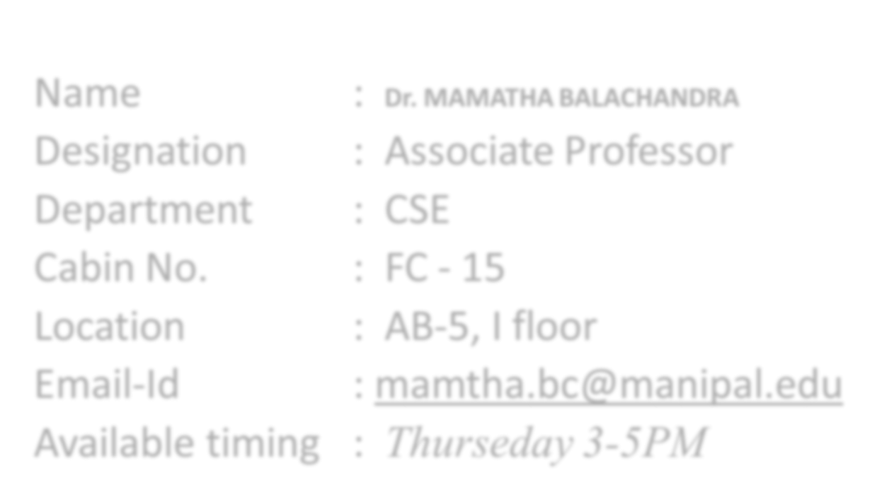
Faculty member Details
Name : Dr. MAMATHA BALACHANDRA
Designation : Associate Professor
Department : CSE
Cabin No. : FC - 15
Location : AB-5, I floor
Email-Id : mamtha.bc@manipal.edu
Available timing : Thurseday 3-5PM
CS-124 Department of CSE

Slide 5
INTRODUCTION TO JAVA

Slide 6
Java is related to C++, which is a direct descendent of C
From C, Java derives its syntax
Many of Java’s object-oriented features were influenced by C++
Java was conceived by James Gosling, Patrick Naughton, Chris Warth, Ed Frank, and Mike Sheridan at Sun Microsystems, Inc. in 1991

Slide 7
The primary motivation was the need for a platform-independent (that is, architecture-neutral) language that could be used to create software to be embedded in various consumer electronic devices, such as microwave ovens and remote controls.
This effort ultimately led to the creation of Java.
About the time that the details of Java were being worked out, a second, and ultimately more important, factor was emerging that would play a crucial role in the future of Java.
This second force was the World Wide Web.

Slide 8
It became obvious to members of the Java design team that the problems of portability frequently encountered when creating code for embedded controllers are also found when attempting to create code for the Internet.
The same problem that Java was initially designed to solve on a small scale could also be applied to the Internet on a large scale. This realization caused the focus of Java to switch from consumer electronics to Internet programming. So, while the desire for an architecture-neutral programming language provided the initial spark, the Internet ultimately led to Java’s large-scale success.

Slide 9
This language was initially called “Oak” but was renamed “Java” in 1995
Java can be used to create two types of programs: applications and applets
An application is a program that runs on your computer, under the operating system of that computer
An applet is an application designed to be transmitted over the Internet and executed by a Java-compatible Web browser

Slide 10
An applet is actually a tiny Java program, dynamically downloaded across the network, just like an image, sound file, or video clip
An applet is a program that can react to user input and dynamically change—not just run the same animation or sound over and over

Slide 11
Security
When you use a Java-compatible Web browser, you can safely download Java applets without fear of viral infection or malicious intent
Java achieves this protection by confining a Java program to the Java execution environment and not allowing access to other parts of the computer environment
Java is portable across many types of computers and operating systems that are in use throughout the world
August 6, 2009

Slide 12
Java’s Magic: The Bytecode
The output of a Java compiler is not executable code ; rather, it is bytecode
Bytecode is a highly optimized set of instructions designed to be executed by the Java run-time system, which is called the Java Virtual Machine (JVM)

Slide 13
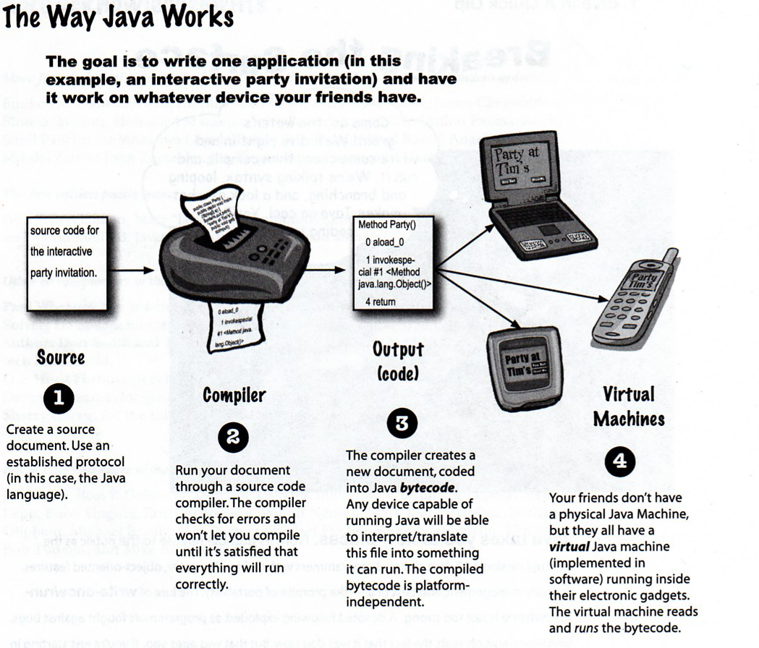
August 6, 2009

Slide 14
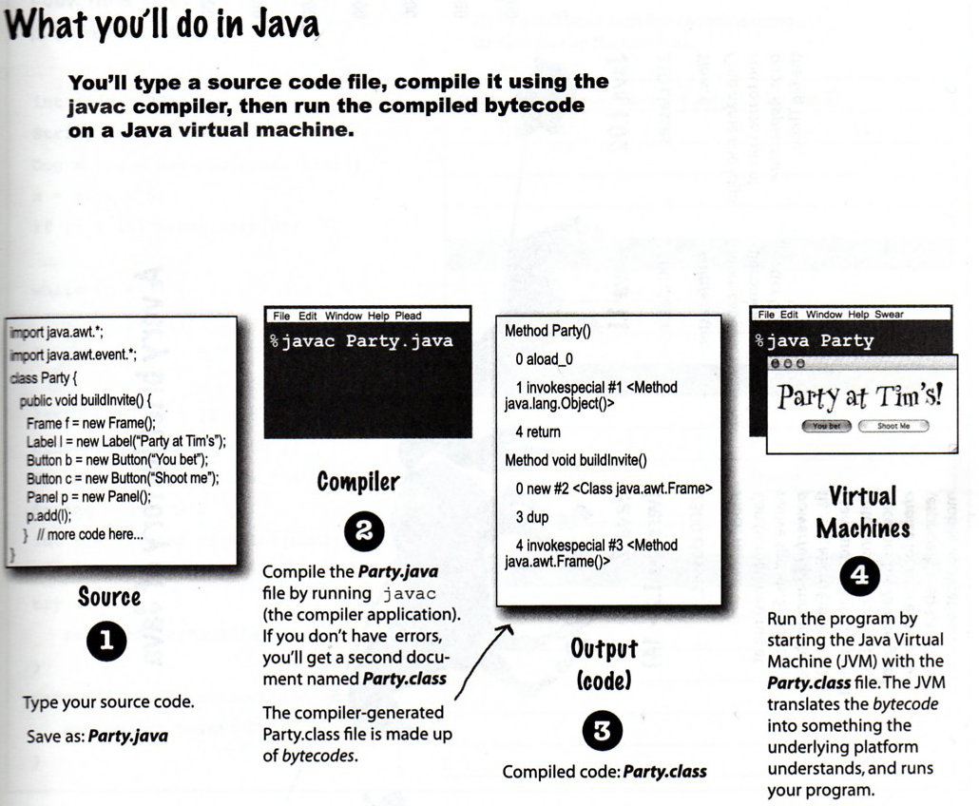
August 6, 2009

Slide 15
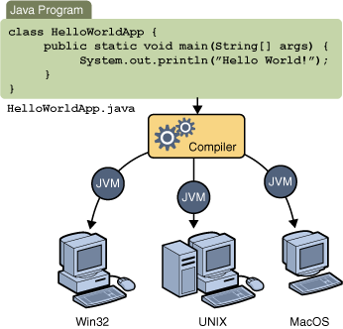

Slide 16
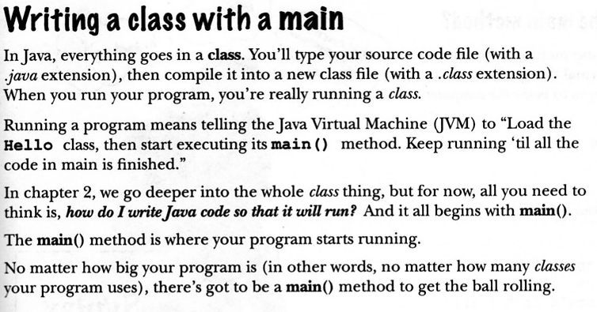
August 6, 2009

Slide 17
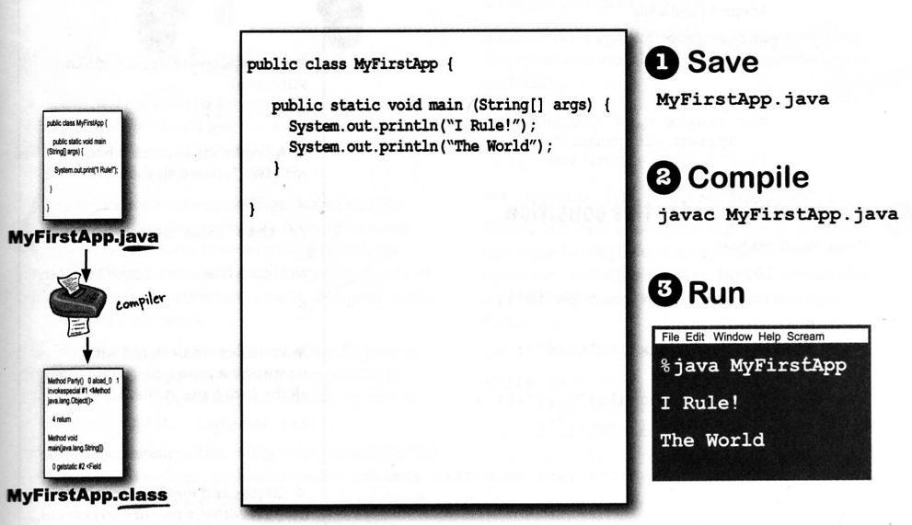
August 6, 2009

Slide 18
JVM is an interpreter for bytecode

Slide 19
Translating a Java program into bytecode helps makes it much easier to run a program in a wide variety of environments
The reason is straightforward: only the JVM needs to be implemented for each platform
When a program is interpreted, it generally runs substantially slower than it would run if compiled to executable code
The use of bytecode enables the Java run-time system to execute programs much faster than you might expect

Slide 20
Sun supplies its Just In Time (JIT) compiler for bytecode, which is included in the Java 2 release
When the JIT compiler is part of the JVM, it compiles bytecode into executable code in real time, on a piece-by-piece, demand basis
The JIT compiler compiles code as it is needed, during execution

Slide 21
The Java Buzzwords
Simple
Secure
Portable
Object-oriented
Robust
Multithreaded
Architecture-neutral
Interpreted
High performance
Distributed
Dynamic
These explain the design goals and accomplishments!

Slide 22
Simple
If you already understand the basic concepts of object-oriented programming, learning Java will be even easier
Because Java inherits the C/C++ syntax and many of the object-oriented features of C++, most programmers have little trouble learning Java
Beyond its similarities with C/C++, Java has another attribute that makes it easy to learn: it makes an effort not to have surprising features
August 6, 2009

Slide 23
Object oriented
Java was not designed to be source-code compatible with any other language
The object model in Java is simple and easy to extend, while simple types, such as integers, are kept as high-performance non-objects
August 6, 2009

Slide 24
Robust
Ability to create robust programs was given a high priority in the design of Java
To better understand how Java is robust, consider two of the main reasons for program failure: memory management mistakes and mishandled exceptional conditions (that is, run-time errors)
August 6, 2009

Slide 25
Memory management can be a difficult, tedious task in traditional programming environments
For example, in C/C++, the programmer must manually allocate and free all dynamic memory
Programmers will either forget to free memory that has been previously allocated or, worse, try to free some memory that another part of their code is still using
August 6, 2009

Slide 26
Pointers- power of pointers with out them
Java virtually eliminates these problems by managing memory allocation and deallocation for you
Java provides object-oriented exception handling
August 6, 2009

Slide 27
Multithreaded
Java supports multithreaded programming, which allows you to write programs that do many things simultaneously
The Java run-time system comes with an elegant yet sophisticated solution for multiprocess synchronization that enables you to construct smoothly running interactive systems
August 6, 2009

Slide 28
Architecture-Neutral
Operating system upgrades, processor upgrades, and changes in core system resources can all combine to make a program malfunction
Java designers made several hard decisions in Java language and Java Virtual Machine in an attempt to alter this situation
Their goal was “write once; run anywhere, any time, forever.” ( W O R A )
August 6, 2009

Slide 29
Interpreted and High Performance
Java enables the creation of cross-platform programs by compiling into an intermediate representation called Java bytecode
This code can be interpreted on any system that provides a Java Virtual Machine
the Java bytecode was carefully designed so that it would be easy to translate directly into native machine code for very high performance by using a just-in-time compiler
August 6, 2009

Slide 30
Distributed
Java is designed for the distributed environment of the Internet, because it handles TCP/IP protocols
Remote Method Invocation (RMI) feature of Java brings an unparalleled level of abstraction to client/server programming
August 6, 2009

Slide 31
Dynamic
Java programs carry with them substantial amounts of run-time type information that is used to verify and resolve accesses to objects at run time.
Makes it possible to dynamically link code in a safe and expedient manner.
Small fragments of bytecode may be dynamically updated on a running system
August 6, 2009

Slide 32
An Overview of Java
August** 6, 2009

Slide 33
Object-oriented programming is at the core of Java
all computer programs consist of two elements: code and data
A program can be conceptually organized around its code or around its data
August 6, 2009

Slide 34
That is, some programs are written around “what is happening” and
others are written around “who is being affected.”
The first way is called the process-oriented model
The process-oriented model can be thought of as code acting on data
August 6, 2009

Slide 35
The second approach, Object-oriented programming organizes a program around its data (that is, objects) and a set of well-defined interfaces to that data
Characterized as data controlling access to the code
August 6, 2009

Slide 36
Concept of Abstraction – focus is on essential features.
Humans manage complexity through abstraction which is through the use of hierarchical classifications.
Data can be transformed into component objects. A sequence of process steps can become a collection of messages between these objects - essence of OOP
August 6, 2009

Slide 37
The Three OOP Principles:
Encapsulation - is the mechanism that binds together code and the data it manipulates, and keeps both safe from outside interference and misuse – class, member variables and methods
Inheritance - the process by which one object acquires the properties of another object
August 6, 2009

Slide 38
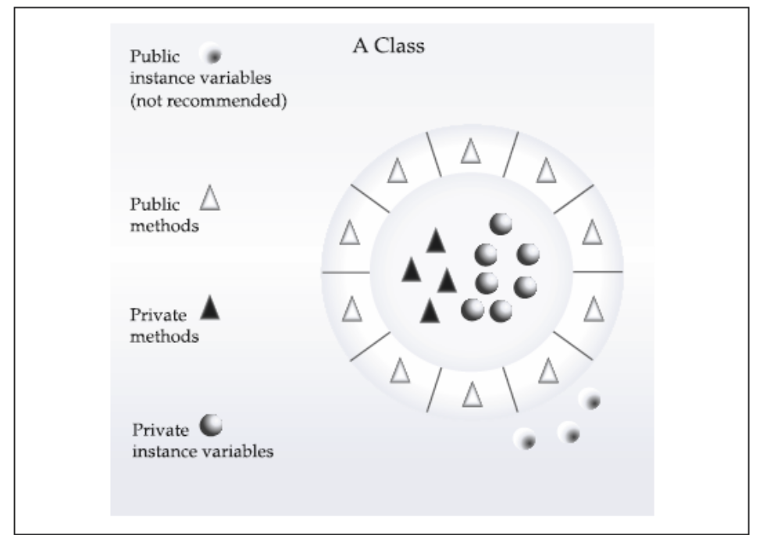
August 6, 2009

Slide 39
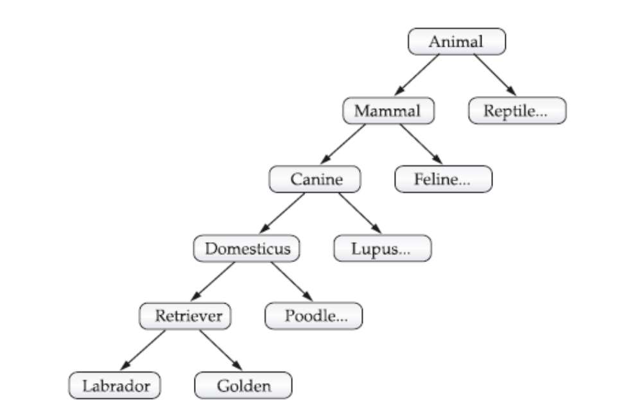
August 6, 2009

Slide 40
Polymorphism - is a feature that allows one interface to be used for a general class of actions – “ one interface , multiple methods”
Polymorphism, encapsulation and inheritance works together - every java program involves these.
August 6, 2009

Slide 41
A First Simple Program
/* This is a simple Java program.
Call this file "Example.java".*/
class Example {
// Your program begins with a call to main().
public static void main(String args[]) {
System.out.println("This is a simple Java program.");
}
}
August 6, 2009

Slide 42
Compiling the Program
C:\>javac Example.java
The javac compiler creates a file called Example.class that contains the bytecode version of the program
The output of javac is not code that can be directly executed
August 6, 2009

Slide 43
To actually run the program, you must use the Java interpreter, called java.
C:\>java Example
When a class member is preceded by public, then that member may be accessed by code outside the class in which it is declared
August 6, 2009

Slide 44
The keyword static allows main( ) to be called without having to instantiate a particular instance of the class
The keyword void simply tells the compiler that main( ) does not return a value
String[ ] args declares a parameter named args, which is an array of instances of the class String. args receives any number of command-line arguments.
August 6, 2009

Slide 45
A Second Short Program
class Example2 {
public static void main(String args[]) {
int num; // this declares a variable called num
num = 100; // this assigns num the value 100
System.out.println("This is num: " + num);
num = num * 2;
System.out.print("The value of num * 2 is ");
System.out.println(num);
}
}
August 6, 2009

Slide 46
Two Control Statements
The if Statement:
if(condition) statement;
if(num < 100)
System.out.println("num is less than 100");
August 6, 2009

Slide 47
The for Loop:
for(initialization; condition; iteration) statement;
class ForTest {
public static void main(String args[]) {
int x;
for(x = 0; x<10; x = x+1)
System.out.println("This is x: " + x);
}
}
August 6, 2009

Slide 48
Using Blocks of Code:
using { and }
August 6, 2009

Slide 49
Lexical Issues
Whitespace:
  Java is a free-form language
  In Java, whitespace is a space, tab, or newline
Identifiers:
- Identifiers are used for class names, method names, and variable names
- Java is case-sensitive
August 6, 2009

Slide 50
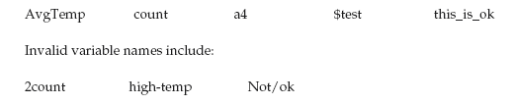
August 6, 2009

Slide 51
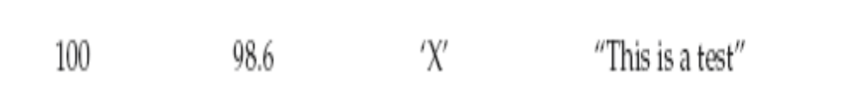
Literals:
A constant value in Java is created by using a literal representation of it
August 6, 2009

Slide 52
Comments
There are three types of comments defined by Java.
Single-line (// )and multiline (/* */ )
The third type is called a documentation comment
This type of comment is used to produce an HTML file that documents your program
The documentation comment begins with a /** and ends with a */
August 6, 2009

Slide 53
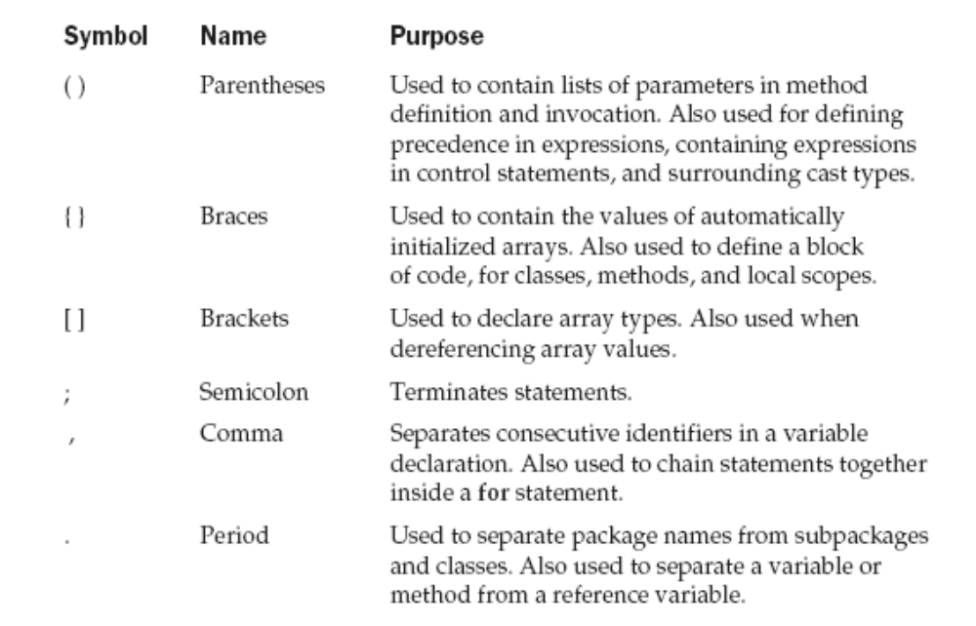
Separators
August 6, 2009

Slide 54
The Java Keywords
There are 50 reserved keywords currently defined in the Java language
Can not be used as names for a variable, class, or method.
const and goto are reserved but not used
Also reserves true, false and null – values defined by Java.
August 6, 2009

Slide 55
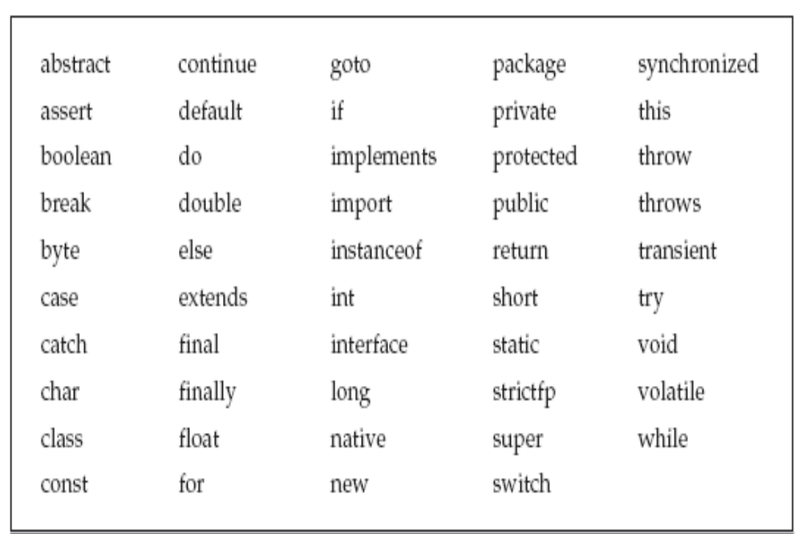
August 6, 2009

